Slide 1

Holistic Response to the Opioid Epidemic: The District of Columbia Experience
MWCOG Regional Opioid and Substance Abuse Summit
Public Safety Panel Session:
Developing a Holistic Response to the Opioid Epidemic
DFC Rafael Sa’adah, BS, MPA, NRP
D.C. Fire & EMS Department
May 9, 2017

Slide 2
Opioid Overdose in DC: Scope of the Issue
Fatal overdoses due to opioid use in DC:
2014: 83
2015: 114
2016: 198
102% increase in fatal overdoses due to opioid use from 2014 to 2016
In 2016, approximately 59% of fatal opioid cases had either fentanyl or a fentanyl analog (fentanyl, furanyl-fentanyl, despropionyl-fentanyl, or p-fluoroisobutyryl-fentanyl) on board.
DC Fire & EMS Narcan administration:
2014: 1,520
2015: 1,731
2016: 3,074
102% increase in Narcan administration by EMS from 2014 to 2016
DC Fire & EMS Naloxone (Narcan) Administration Count, CY 2014-2016
 | 2014 | 2015 | 2016
Total | 1,520 | 1,731 | 3,074
Sources: D.C. Office of the Chief Medical Examiner; D.C. Fire & EMS.

Slide 3
The Holistic Response
FEMS
MPD
Hospitals
DFS
OCME
Emergency Response
Testing
Public Health Response
Criminal Justice system
OAG
MPD and DEA
CJCC
CSOSA
DOC
US Attorney
DOH
DBH
DHS

Slide 4
Key Elements of the D.C. Approach to
the Opioid Overdose Epidemic
Build a Big Table: Convene government working groups that involve all relevant disciplines: including public health, public safety, and criminal justice. Share information across silos.
Use Big Data: Use public health epidemiological resources and techniques to analyze big data sets (EMS, hospital, medical examiner) to learn where, when, who and what is driving the epidemic in your community.
Prevent Death: Get Narcan to the patient; keep them alive.
Guide People to Treatment: Use big data and research findings to drive targeted community and individual public health interventions.

Slide 5
Build a Big Table: Convene government working groups that involve all relevant disciplines: including public health, public safety, and criminal justice. Share information across silos.
Key Working Groups:
Heroin Working Group
Chaired by the Director of the Department of Health, meets monthly. All DC govt. public health and public safety agencies participate, plus external guest agencies such as DEA. Develops recommendations for the Executive, implements city-wide policy.
Criminal Justice Coordinating Council (CJCC) New Psychoactive Substances (NPS) Work Group
Meets bi-monthly, overlapping membership with above, plus criminal justice, courts (pre-trial services), probation and parole, corrections, etc. Facilitates collaboration on public safety issues involving multiple criminal justice or public safety agencies.
Washington Regional Threat and Analysis Center (Fusion Center) Opioid Work Group
Meets on an ad hoc basis to foster exchange of information and intelligence related to the opioid epidemic.
Focus of group:
Public Health and Epidemiological approach, with input and participation from Public Safety
Public Safety and Criminal Justice, with input and participation from Public Health
Law Enforcement, with input and participation from Public Health, Criminal Justice, and Public Safety

Slide 6
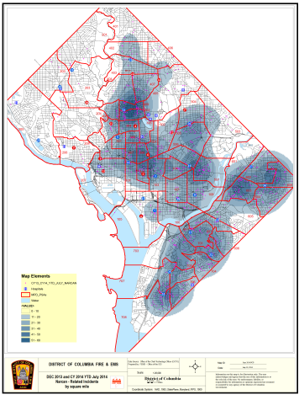
Use Big Data: Use public health epidemiological resources and techniques to analyze big data sets (EMS, hospital, medical examiner) to learn where, when, who and what is driving the epidemic in your community.
Key big data sets that can inform and guide your opioid overdose prevention and response strategy:
EMS
Hospitals
Medical examiner
Pre-trial Services

Slide 7
Use Big Data: Use public health epidemiological resources and techniques to analyze big data sets (EMS, hospital, medical examiner) to learn where, when, who and what is driving the epidemic in your community.
Where and when:
Narcan administration can be used (with limitations) as a surrogate tool to alert you in real time to potential geographic and temporal (rate-of-rise) overdose clusters. Enable push notifications from your ePCR system.
Density mapping using ArcGIS and EMS datasets. (Key point: geospatial (x-y) coordinates should be converted to hundred-blocks or polygons to avoid identifying individual addresses.)
Leverage your exiting syndromic and bio-surveillance systems: CRISP (Chesapeake Regional Information System for our Patients), ESSENCE (Electronic Surveillance System for the Early Notification of Community-based Epidemics), FirstWatch, etc.
HIPAA is your friend, not your enemy—involve your general counsel and/or HIPAA compliance officer on the front end when designing your programs. Create formal data-sharing agreements with key partners.

Slide 8
Use Big Data: Use public health epidemiological resources and techniques to analyze big data sets (EMS, hospital, medical examiner) to learn where, when, who and what is driving the epidemic in your community.
Who:
EMS data, properly managed and reviewed, can be a useful source of information on drug use trends and biostatistics in your community.
Key point: If using Narcan administration as a vector to identify opioid overdose, manual review is necessary to screen out false positives.
Demographics of suspected opioid overdoses treated by DC Fire & EMS, Summer 2015
Age range | 19 to 68 years
Average Age | 51.3 years
Median Age | 55 years
Gender | 81% male 19% female
Race | 83% African-American 15% White 2% Hispanic
Residency | 87% DC residents 6% MD residents 5% VA residents 2% other

Slide 9
Use Big Data: Use public health epidemiological resources and techniques to analyze big data sets (EMS, hospital, medical examiner) to learn where, when, who and what is driving the epidemic in your community.
What:
Medical examiner data can reveal what compounds are driving fatal overdoses. This information, in turn, can be mapped to the location of the overdose and/or the neighborhood of the victim.

Slide 10
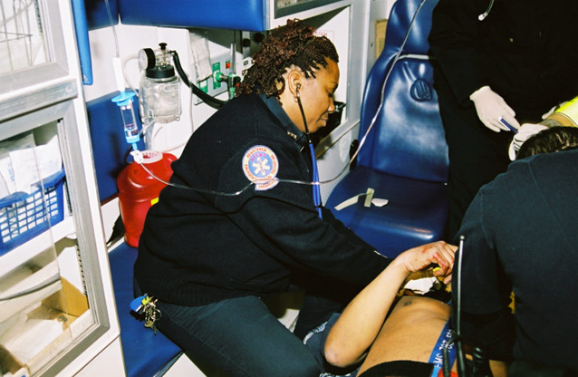
Prevent Death: Get Narcan to the patient; keep them alive.
Narcan has been a Basic Life Support (BLS) drug for DC EMS since 2002.
Every fire truck and ambulance in the city carries Narcan.
Every firefighter, EMT and Paramedic can give Narcan.
DC Fire & EMS administered Narcan to over 3,000 unique patients in 2016.
Administered nasally to reduce risk of injury.
Available by prescription to DC residents.
Health department coordinates training and distribution of Narcan kits to lay personnel who work with drug users.

Slide 11
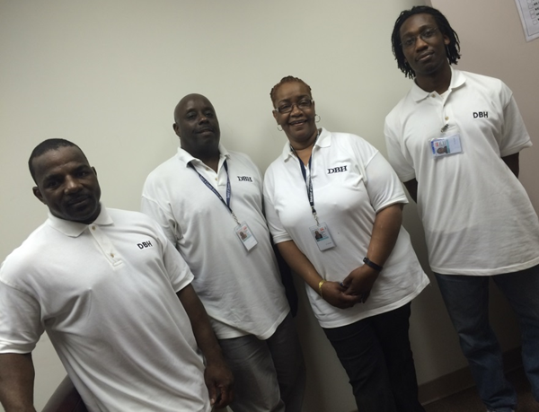
Guide People to Treatment: Use big data and research findings to drive targeted community and individual public health interventions.
Fire & EMS and Department of Behavioral Health Partnership: 2015 Heroin Screening, Brief Intervention and Treatment (SBIRT) Pilot Program
Goal: Home visit from clinical outreach team within seven days of suspected heroin overdose for every victim in DC. Voluntary offer of referral and immediate transport to treatment.
Results: 54% of persons contacted committed to treatment plan (including 21% who were transported directly to treatment intake).

Slide 12
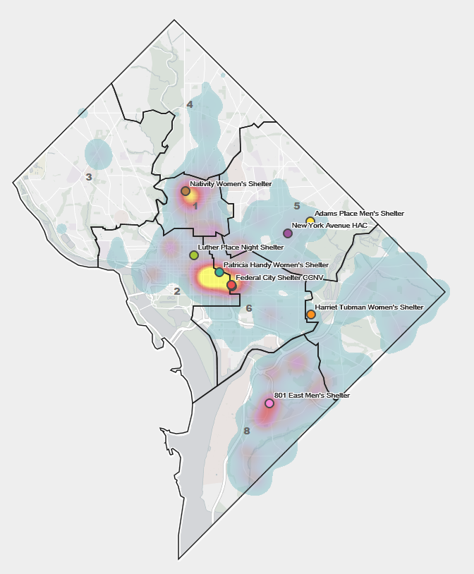
Guide People to Treatment: Use big data and research findings to drive targeted community and individual public health interventions.
2017 SBIRT II Pilot Program:
Use EMS data to drive targeted intervention by Department of Behavioral Health outreach teams to a core group of repeat synthetic cannabinoid overdose victims at the District’s largest homeless shelter.

Slide 13
Acknowledgements Grateful acknowledgment is made of the leadership and contributions of the following persons in the fight to reduce death and disability from opioid use and overdose in the District of Columbia. The opinions expressed in this presentation may not necessarily represent those of the District of Columbia government or these persons. The presenter is solely responsible for any errors or omissions. Dr. LaQuandra Nesbitt, Director, DC Department of Health Dr. Tanya Royster, Director, DC Department of Behavioral Health Dr. Roger Mitchell, DC Office of the Chief Medical Examiner Dr. Jenifer Smith, Director, DC Department of Forensic Sciences Chief Gregory Dean, Fire & EMS Chief, DC Fire & EMS Dr. Robert Holman, Assistant Chief/Medical Director, DC Fire & EMS Dr. Neha Puppala, Deputy Medical Director, DC Fire & EMS Mr. Erik Johnson, Senior GIS Analyst, DC Fire & EMS Dr. John Davies-Cole, Chief of Epidemiology, DC Department of Health Mr. Kenan Zamore, Senior Research Epidemiologist, DC Department of Health Dr. Marquitta Duvernay, Deputy Director, DC Department of Behavioral Health Ms. Tricialand Hilliard, Treatment Program Coordinator, DC Department of Behavioral Health Ms. Jessica Bress, Special Assistant, DC Department of Behavioral Health Dr. Chiharlo Leak, Forensic Epidemiologist, DC Office of the Chief Medical Examiner Mr. Lucas W. Zarwell, Chief Toxicologist, DC Office of the Chief Medical Examiner Lt. Andrew Struhar, Metropolitan Police Department Ms. Mannone Butler, Esq., Executive Director, Criminal justice Coordinating Council Mr. Luis Diaz, Esq., Policy Analyst, Criminal Justice Coordinating Council Mr. Michael Kharfen, Senior Deputy Director, DC Department of Health Dr. Travis A. Gayles, Chief Medical Officer HAHSTA, DC Department of Health Ms. Jennifer Del Toro, Intelligence Analyst, Washington Regional Threat Analysis Center Ms. Lia Katz, Applied Research Analyst, Office of the City Administrator

Slide 14
Follow-up questions may be addressed to : rafael.saadah@dc.gov 202-302-5285

